Slide 1
Advanced Attention Mechanisms & MOE
CS XXX: Introduction to Large Language Models

Slide 2
Contents
Optimizing Attention
KV Cache
Sliding Window Attention
Multi-query Attention
Grouped-query Attention
Flash Attention
Mixture of Experts

Slide 3
Optimizing Attention
The area that gets the most focus from the research community is the attention layer of the Transformer. This is because the attention calculation is the most computationally expensive part of the process.

Slide 4
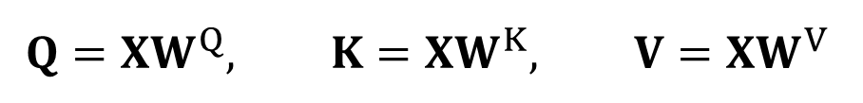
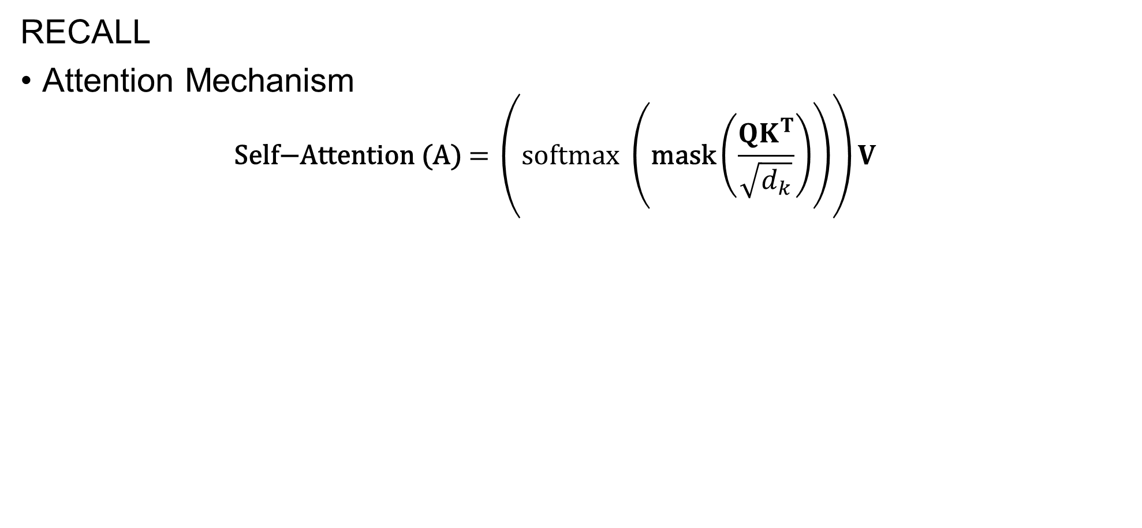
KV Cache
RECALL
Attention Mechanism
$$\text{Self}\text{−}\text{Attention}\text{ (}\text{A}\text{)}\text{ = }\left(\text{softmax} \left(\text{mask}\left(\frac{{QK}^{T}}{\sqrt{d_{k}}}\right)\right)\right)V$$
$$Q=XW^{Q}, K=XW^{K}, V=XW^{V}$$

Slide 5
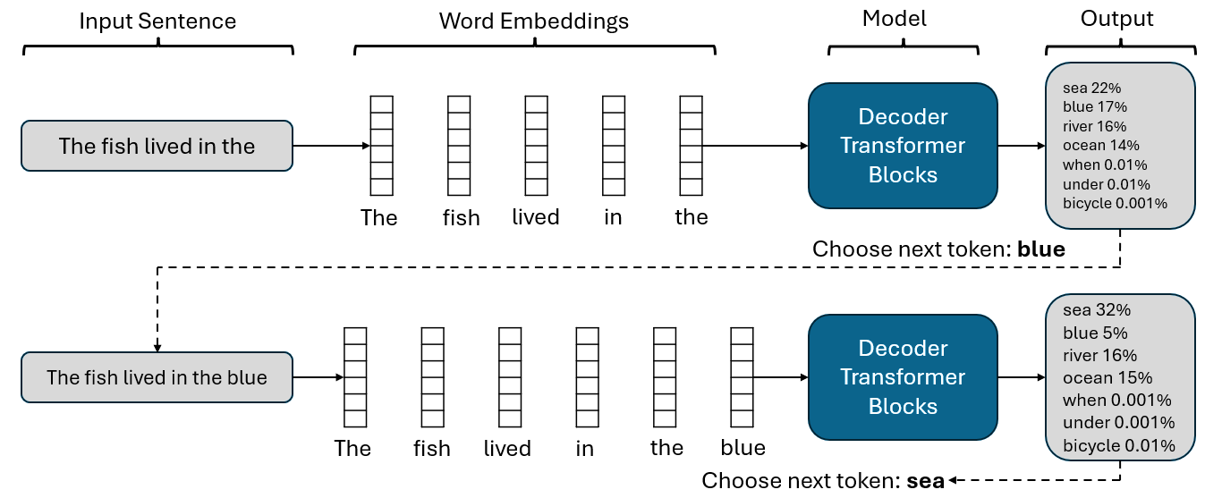
KV Cache
RECALL
Token by token generation: Recall that when generating the second token, we simply append the output token to the input and do another forward pass through the model.

Slide 6
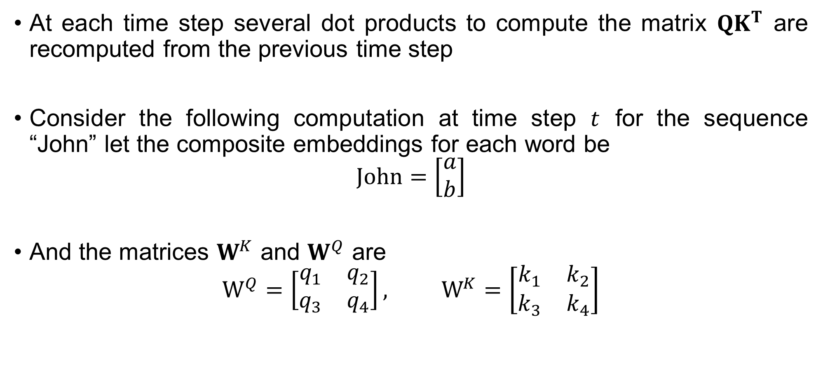
KV Cache
At each time step several dot products to compute the matrix $QK^{T}$ are recomputed from the previous time step
Consider the following computation at time step $t$ for the sequence “John” let the composite embeddings for each word be
$$\text{John}=\left[\begin{matrix}a \\ b\end{matrix}\right]$$
And the matrices $W^{K}$ and $W^{Q}$ are
$$W^{Q}=\left[\begin{matrix}q_{1} & q_{2} \\ q_{3} & q_{4}\end{matrix}\right], W^{K}=\left[\begin{matrix}k_{1} & k_{2} \\ k_{3} & k_{4}\end{matrix}\right]$$

Slide 7
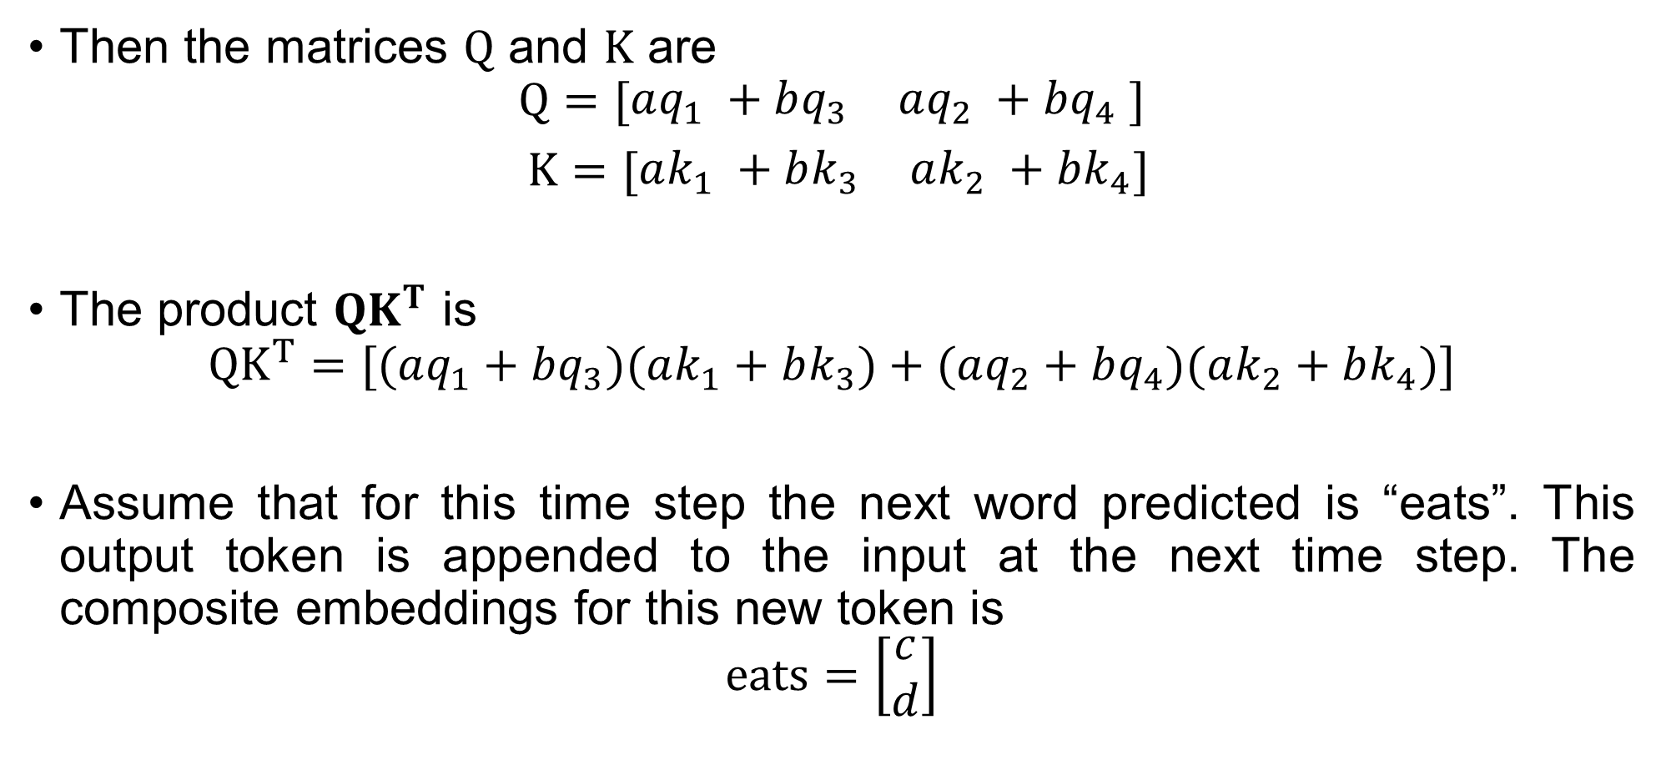
KV Cache
Then the matrices $Q$ and $K$ are
$$Q=[\begin{matrix}aq_{1}​ +bq_{3} & aq_{2}​ +bq_{4}​ ​\end{matrix}]$$
$K=[\begin{matrix}ak_{1}​ +bk_{3} & ak_{2}​ +bk_{4}\end{matrix}]$
The product $QK^{T}$ is
$$QK^{T}=[(aq_{1}​+bq_{3}​)(ak_{1}​+bk_{3}​)+(aq_{2}​+bq_{4​})(ak_{2}​+bk_{4}​)]$$
Assume that for this time step the next word predicted is “eats”. This output token is appended to the input at the next time step. The composite embeddings for this new token is
$$\text{eats}=\left[\begin{matrix}c \\ d\end{matrix}\right]$$

Slide 8
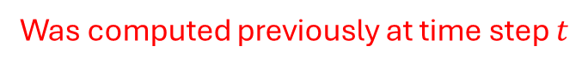
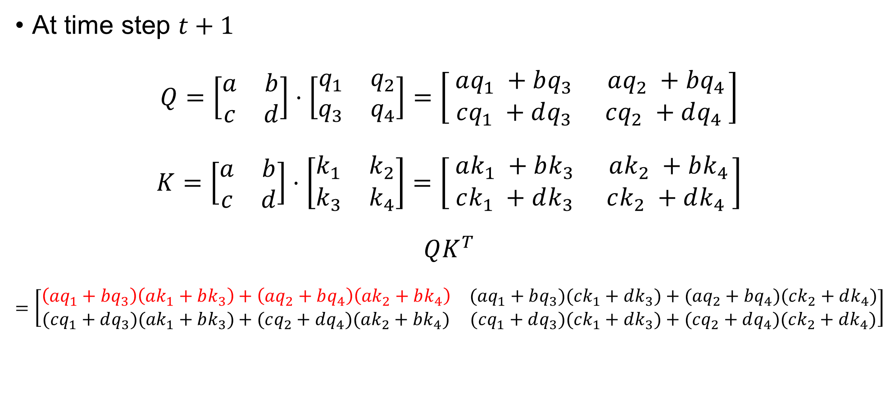
KV Cache
At time step $t+1$
$$Q=\left[\begin{matrix}a & b \\ c & d\end{matrix}\right]⋅\left[\begin{matrix}q_{1} & q_{2} \\ q_{3} & q_{4}\end{matrix}\right]=\left[\begin{matrix}aq_{1}​ +bq_{3} & aq_{2}​ +bq_{4}​ \\ ​ cq_{1}​ +dq_{3}​ ​ & cq_{2}​ +dq_{4}​ ​\end{matrix}\right]$$
$$K=\left[\begin{matrix}a & b \\ c & d\end{matrix}\right]⋅\left[\begin{matrix}k_{1} & k_{2} \\ k_{3} & k_{4}\end{matrix}\right]=\left[\begin{matrix}ak_{1}​ +bk_{3} & ak_{2}​ +bk_{4}​ \\ ​ ck_{1}​ +dk_{3}​ ​ & ck_{2}​ +dk_{4}​ ​\end{matrix}\right]$$
$$QK^{T}$$
$$=\left[\begin{matrix}\left(aq_{1}​+bq_{3}​\right)\left(ak_{1}​+bk_{3}​\right)+\left(aq_{2}​+bq_{4​}\right)\left(ak_{2}​+bk_{4}​\right) & (aq_{1}​+bq_{3}​)(ck_{1}​+dk_{3}​)+(aq_{2}​+bq_{4}​)(ck_{2​}+dk_{4}​) \\ (cq_{1}​+dq_{3}​)(ak_{1}​+bk_{3}​)+(cq_{2}​+dq_{4}​)(ak_{2}​+bk_{4}​)​ & (cq_{1}​+dq_{3}​)(ck_{1}​+dk_{3}​)+(cq_{2}​+dq_{4}​)(ck_{2}​+dk_{4}​)​\end{matrix}\right]$$
Was computed previously at time step $t$

Slide 9
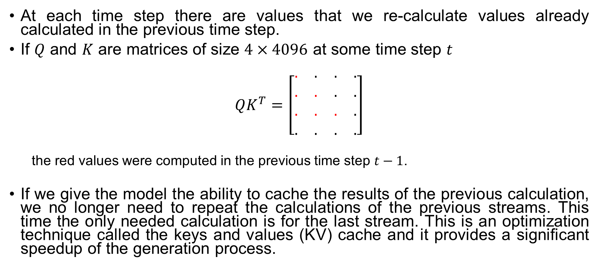
KV Cache
At each time step there are values that we re-calculate values already calculated in the previous time step.
If $Q$ and $K$ are matrices of size $4×4096$ at some time step $t$
$$QK^{T}=\left[\begin{matrix}. & . & . & . \\ . & . & . & . \\ . & . & . & . \\ . & . & . & .\end{matrix}\right]$$
the red values were computed in the previous time step $t−1$.
If we give the model the ability to cache the results of the previous calculation, we no longer need to repeat the calculations of the previous streams. This time the only needed calculation is for the last stream. This is an optimization technique called the keys and values (KV) cache and it provides a significant speedup of the generation process.

Slide 10
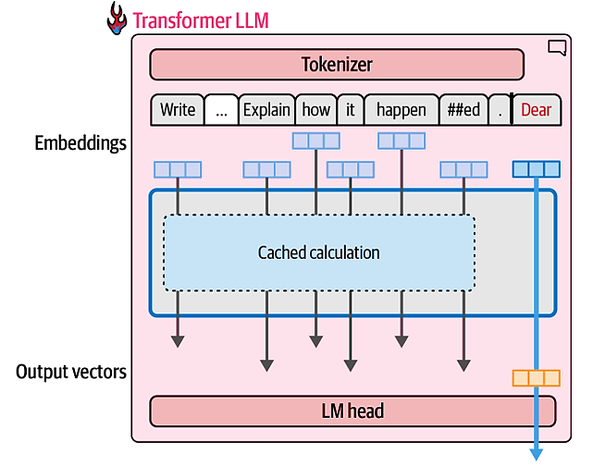
KV Cache
When generating text, it’s important to cache the computation results of previous tokens instead of repeating the same calculation over and over again

Slide 11
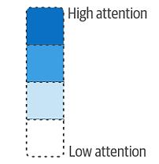
Sliding Window Attention
Attention scores determine how strongly the model on the relationship between certain words
"love" has high attention on "llamas," it means the model considers "love" important in relation to "llamas."
 | I | love | llamas | for | life
I
love
llamas
for
life

Slide 12
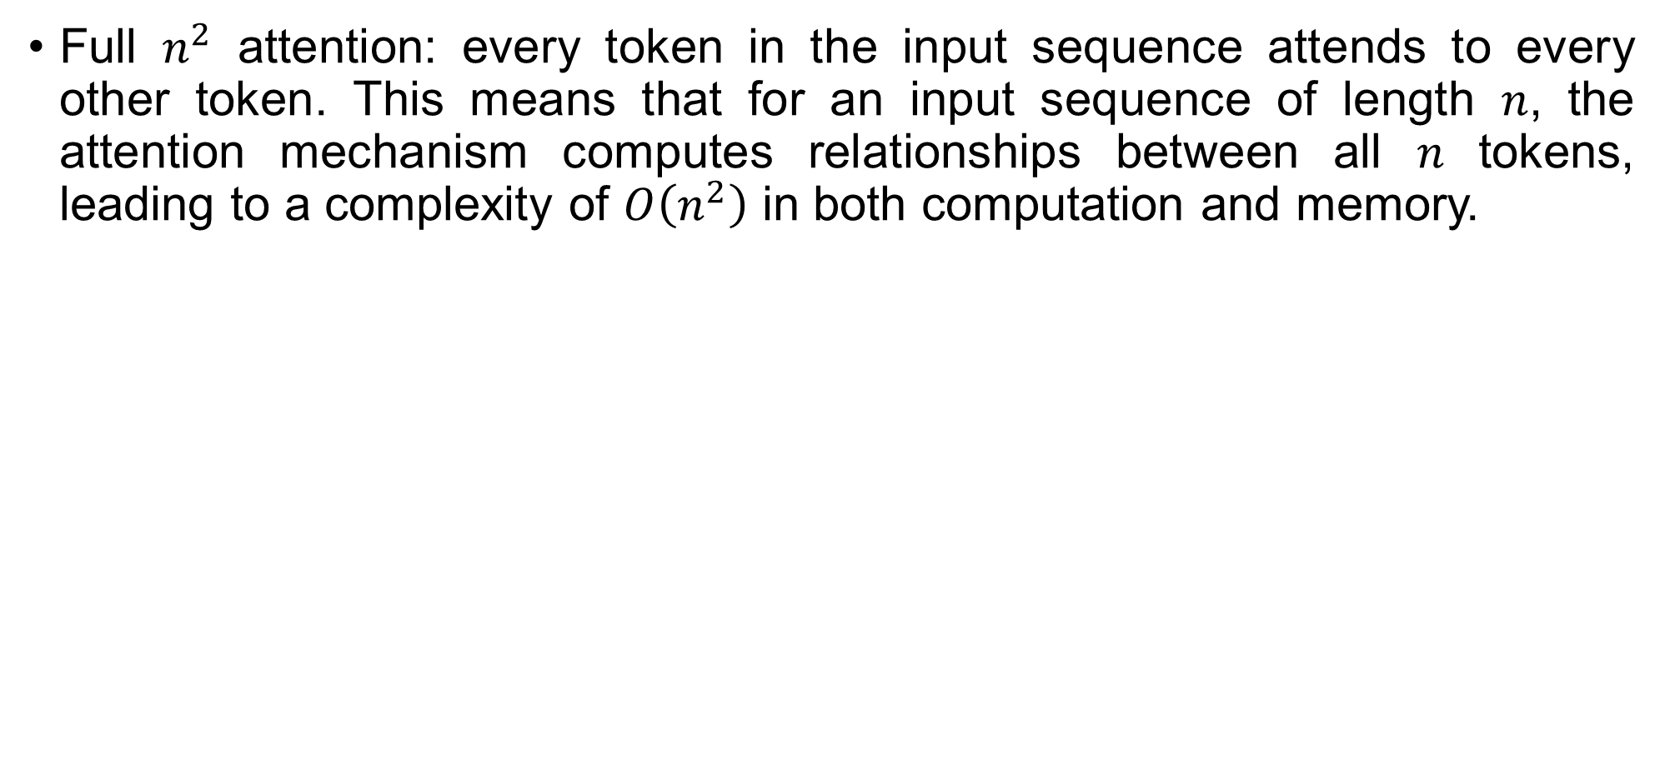
Sliding Window Attention
Full $n^{2}$ attention: every token in the input sequence attends to every other token. This means that for an input sequence of length 𝑛, the attention mechanism computes relationships between all 𝑛 tokens, leading to a complexity of $O\left(n^{2}\right)$ in both computation and memory.
 | I | love | llamas | for | life
I
love
llamas
for
life

Slide 13
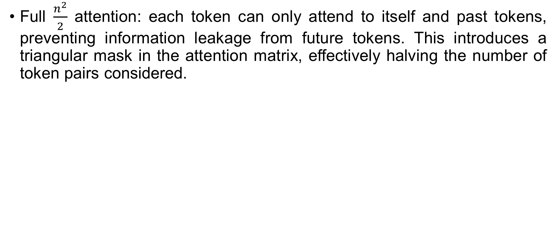
Sliding Window Attention
Full $\frac{n^{2}}{2}$ attention: each token can only attend to itself and past tokens, preventing information leakage from future tokens. This introduces a triangular mask in the attention matrix, effectively halving the number of token pairs considered.
 | I | love | llamas | for | life
I
love
llamas
for
life

Slide 14
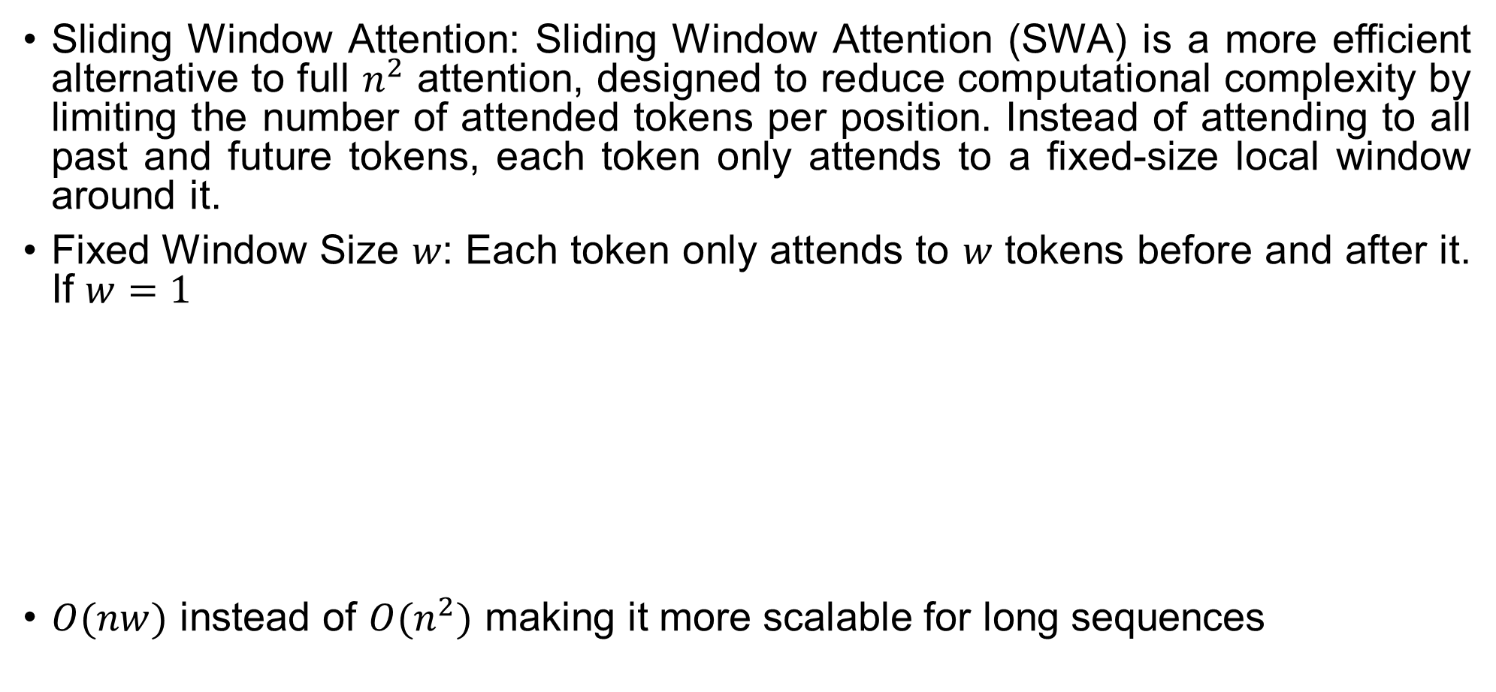
Sliding Window Attention
Sliding Window Attention: Sliding Window Attention (SWA) is a more efficient alternative to full $n^{2}$ attention, designed to reduce computational complexity by limiting the number of attended tokens per position. Instead of attending to all past and future tokens, each token only attends to a fixed-size local window around it.
Fixed Window Size 𝑤: Each token only attends to 𝑤 tokens before and after it. If $w=1$
$O(nw)$ instead of $O(n^{2})$ making it more scalable for long sequences
 | I | love | llamas | for | life
I
love
llamas
for
life

Slide 15
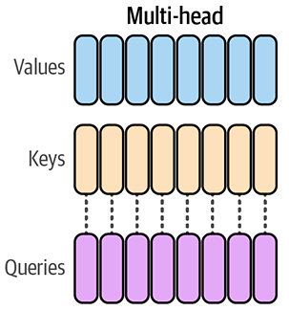
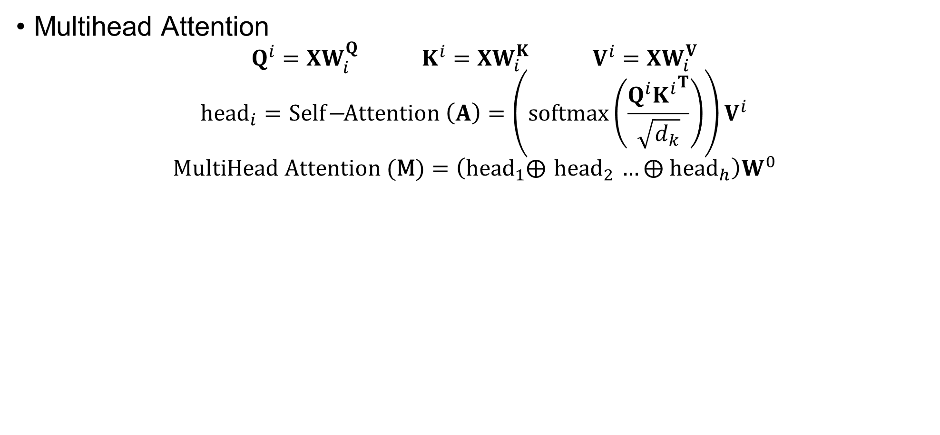
Multi Query Attention
Multihead Attention
$$Q^{i}=XW_{i}^{Q} K^{i}=XW_{i}^{K} V^{i}=XW_{i}^{V}$$
$${\text{head}}_{i}=\text{Self}\text{−}\text{Attention} \left(A\right)=\left(\text{softmax}\left(\frac{{Q^{i}K^{i}}^{T}}{\sqrt{d_{k}}}\right)\right)V^{i}$$
$$\text{MultiHead} \text{Attention} \text{(}\text{M}\text{)}=\left({\text{head}}_{1}⨁{ \text{head}}_{2} …⨁{ \text{head}}_{h}\right)W^{0}$$
Separate key and value matrices for each head

Slide 16
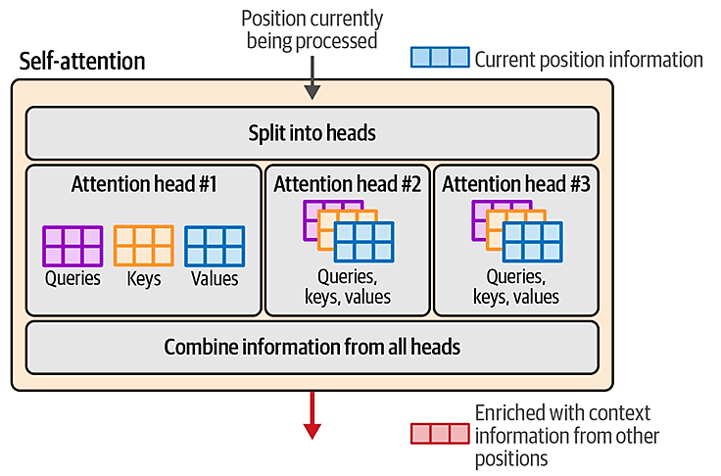
Multi Query Attention
Multihead Attention
Attention is conducted using matrices of queries, keys, and values. In multi-head attention, each head has a distinct version of each of these matrices.

Slide 17
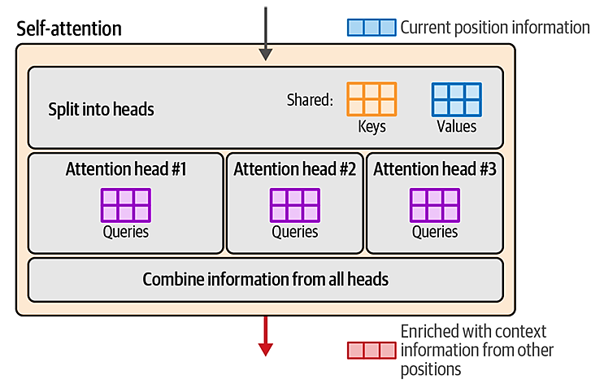
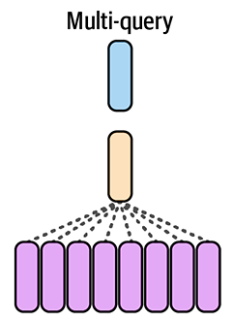
Multi Query Attention
Multi-query attention presents a more efficient attention mechanism by sharing the keys and values matrices across all the attention heads.

Slide 18
Grouped Query Attention
As model sizes grow, however, multi-query optimization can be too punishing and we can afford to use a little more memory to improve the quality of the models. This is where grouped-query attention comes in. Instead of cutting the number of keys and values matrices to one of each, it allows us to use more (but less than the number of heads).

Slide 19
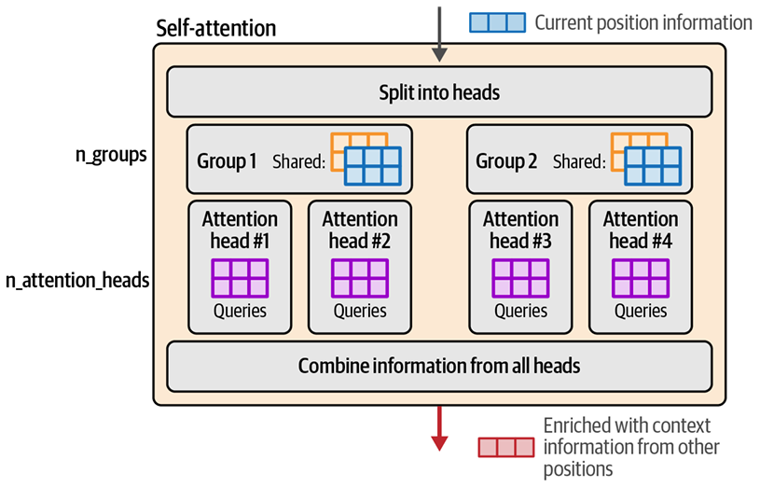
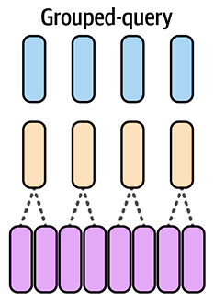
Grouped Query Attention
Grouped-query attention sacrifices a little bit of the efficiency of multi query attention in return for a large improvement in quality by allowing multiple groups of shared key/value matrices; each group has its respective set of attention heads.

Slide 20
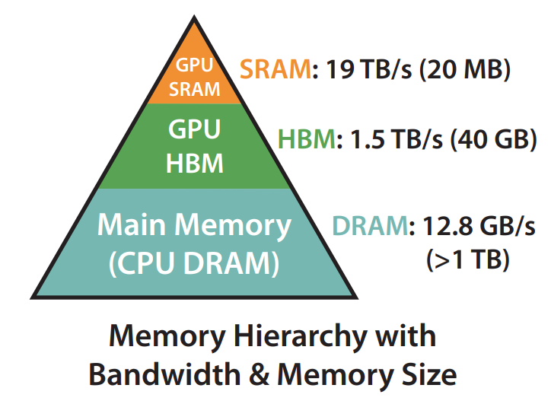
Flash Attention
Flash Attention is a popular method and implementation that provides significant speedups for both training and inference of Transformer LLMs on GPUs. It speeds up the attention calculation by optimizing what values are loaded and moved between a GPU’s shared memory (SRAM) and high bandwidth memory (HBM).
SRAM: Speed (19 TB/s) / Storage (20 MB) – Faster computation but very little storage
HBM (GPU main memory): Speed (1.5 TB/s) / Storage (40 GB) – Slower computation and access (loading from and writing to) but lots of storage

Slide 21
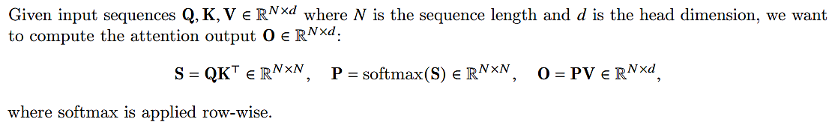
Flash Attention
Standard Attention
1 2 3 4 5 6 7 8 9 | Require: Matrices Q, K, V in HBM Load Q, K from HBM Compute S = QK^{T} Write S to HBM. Read S from HBM Compute P = softmax(S) write P to HBM. Load P and V by blocks from HBM Compute O = PV write O to HBM.

Slide 22
Flash Attention
Standard Attention
1 2 3 | Require: Matrices Q, K, V in HBM Load Q, K from HBM compute S = QK^{T} Write S to HBM. Read S from HBM Compute P = softmax(S) Write P to HBM. Load P and V from HBM Compute O = PV Write O to HBM.

Slide 23
Flash Attention
Standard Attention
Number of reads from the HBM = 3
Number of writes to HBM = 3
1 2 3 | Require: Matrices Q, K, V in HBM Load Q, K from HBM compute S = QK^{T} Write S to HBM. Read S from HBM Compute P = softmax(S) Write P to HBM. Load P and V from HBM Compute O = PV Write O to HBM.
Goal of flash attention: Reduce HBM accesses, Do most of the computation using SRAM

Slide 24
Flash Attention
Goal of Flash Attention
Number of Reads: 1
Number of Writes: 1
Total Accesses = 2
1 2 3 4 5 | Require: Matrices Q, K, V in HBM Load Q, K, V Block from HBM Compute S = QK^{T} Compute P = softmax(S) Compute O = PV write O to HBM.
Do all the computation using SRAM without having to read and write to HBM at each step because of the limited storage of the SRAM

Slide 25
Flash Attention
Goal of Flash Attention
To utilize SRAM memory efficiently Flash attention uses tiling: The Q, K, V matrices are split into blocks and then attention is computed by blocks.
Tiling enables computation to be in one CUDA kernel, loading input from HBM, performing all the computation steps (matrix multiply, softmax, optionally masking and dropout, matrix multiply), then write the result back to HBM
1 2 3 4 5 | Require: Matrices Q, K, V in HBM Load Q, K, V from HBM Compute S = QK^{T} Compute P = softmax(S) Compute O = PV write O to HBM.
Do all the computation using SRAM without having to read and write to HBM at each step because of the limited storage of the SRAM

Slide 26
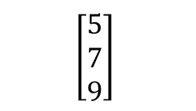
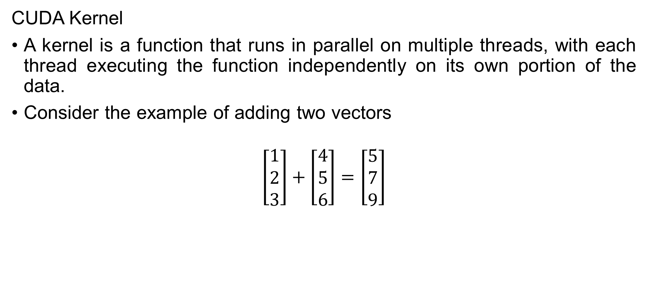
Flash Attention
CUDA Kernel
A kernel is a function that runs in parallel on multiple threads, with each thread executing the function independently on its own portion of the data.
Consider the example of adding two vectors
$$\left[\begin{matrix}1 \\ 2 \\ 3\end{matrix}\right]+\left[\begin{matrix}4 \\ 5 \\ 6\end{matrix}\right]=\left[\begin{matrix}5 \\ 7 \\ 9\end{matrix}\right]$$
a=1, b=4
Thread 1
Thread 1
$$\left[\begin{matrix}5 \\ 7 \\ 9\end{matrix}\right]$$
a=2, b=5
Thread 2
1 2 | def kernel_add(a,b): return a+b
Thread 2
Thread 3
a=3, b=6
Thread 3

Slide 27
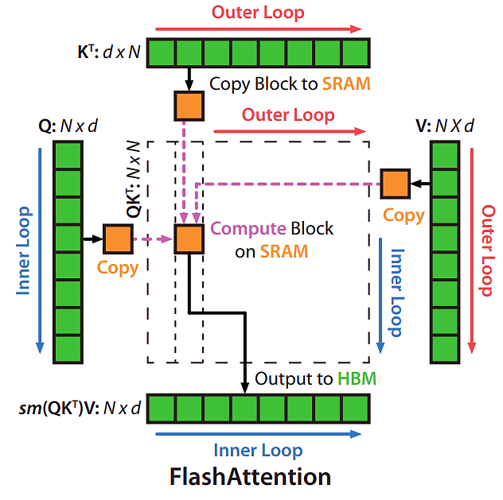
Flash Attention
Tiling: Attention Computation by blocks

Slide 28
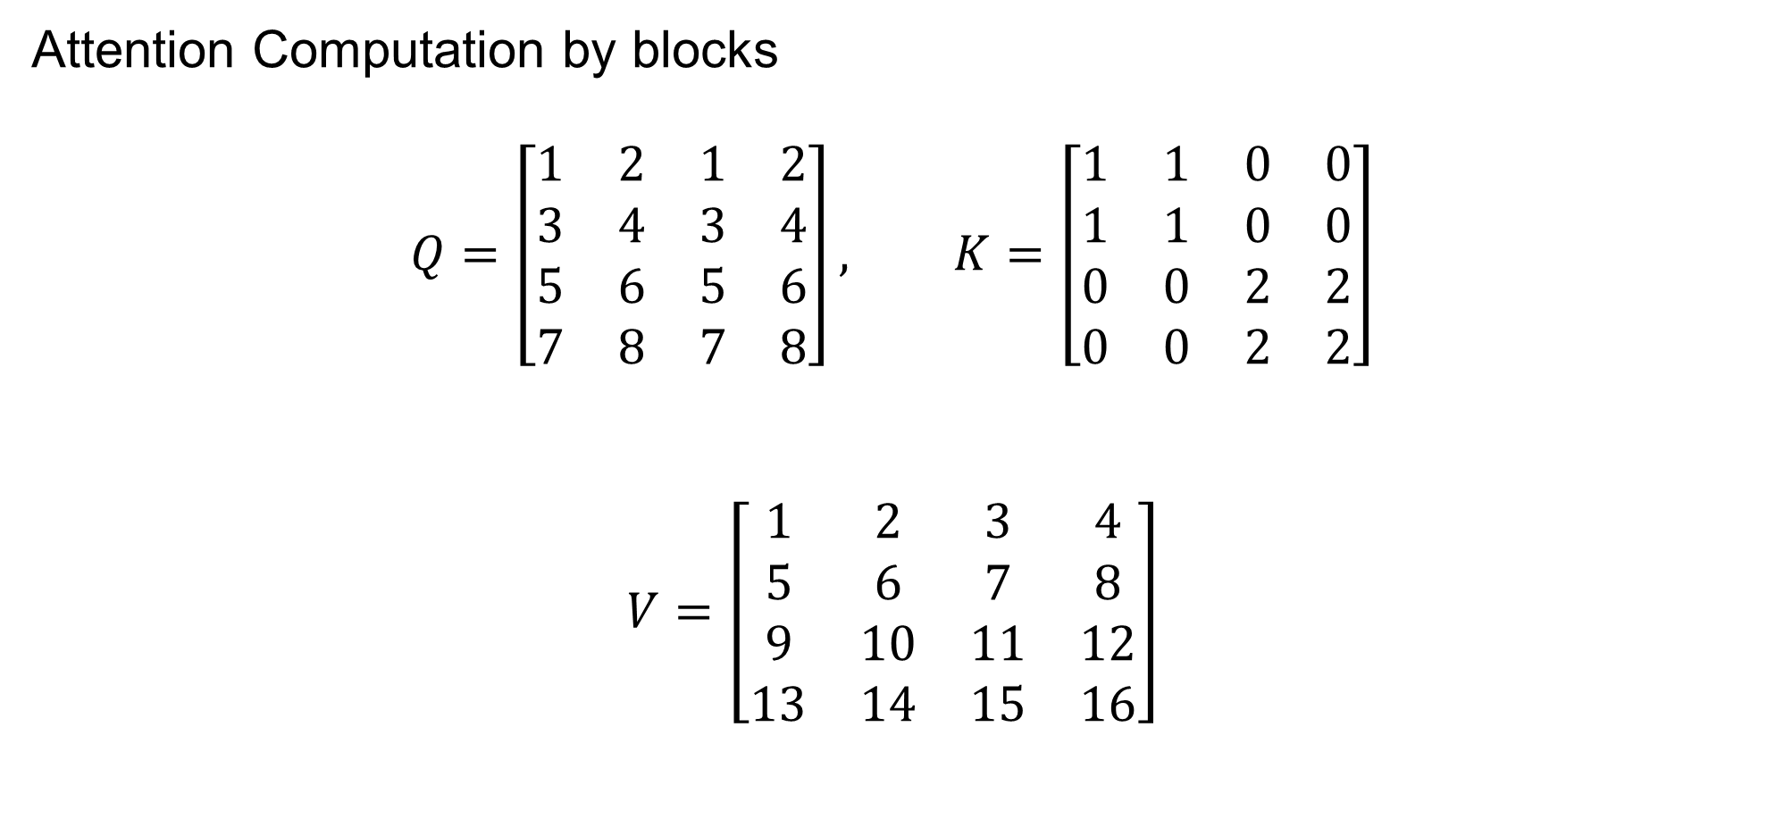
Flash Attention
Attention Computation by blocks
$$Q=\left[\begin{matrix}1 & 2 & 1 & 2 \\ 3 & 4 & 3 & 4 \\ 5 & 6 & 5 & 6 \\ 7 & 8 & 7 & 8\end{matrix}\right], K=\left[\begin{matrix}1 & 1 & 0 & 0 \\ 1 & 1 & 0 & 0 \\ 0 & 0 & 2 & 2 \\ 0 & 0 & 2 & 2\end{matrix}\right]$$
$$V=\left[\begin{matrix}1 & 2 & 3 & 4 \\ 5 & 6 & 7 & 8 \\ 9 & 10 & 11 & 12 \\ 13 & 14 & 15 & 16\end{matrix}\right]$$

Slide 29
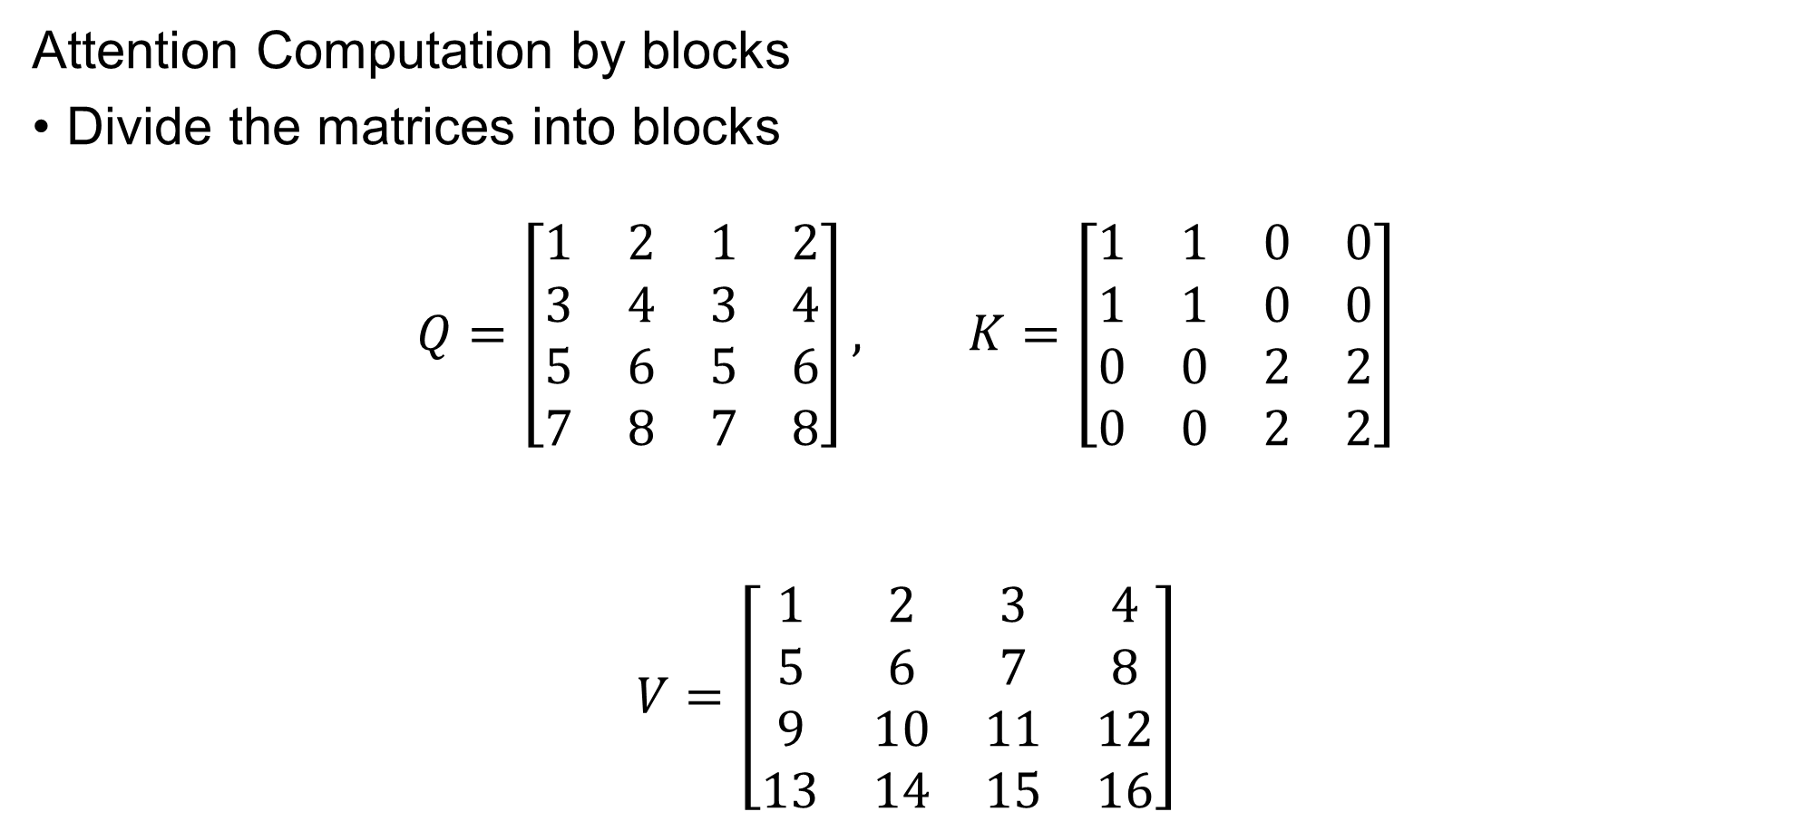
Flash Attention
Attention Computation by blocks
Divide the matrices into blocks
$$Q=\left[\begin{matrix}1 & 2 & 1 & 2 \\ 3 & 4 & 3 & 4 \\ 5 & 6 & 5 & 6 \\ 7 & 8 & 7 & 8\end{matrix}\right], K=\left[\begin{matrix}1 & 1 & 0 & 0 \\ 1 & 1 & 0 & 0 \\ 0 & 0 & 2 & 2 \\ 0 & 0 & 2 & 2\end{matrix}\right]$$
$$V=\left[\begin{matrix}1 & 2 & 3 & 4 \\ 5 & 6 & 7 & 8 \\ 9 & 10 & 11 & 12 \\ 13 & 14 & 15 & 16\end{matrix}\right]$$
1
2
1
2
3
4
3
4
1
2
3
4

Slide 30
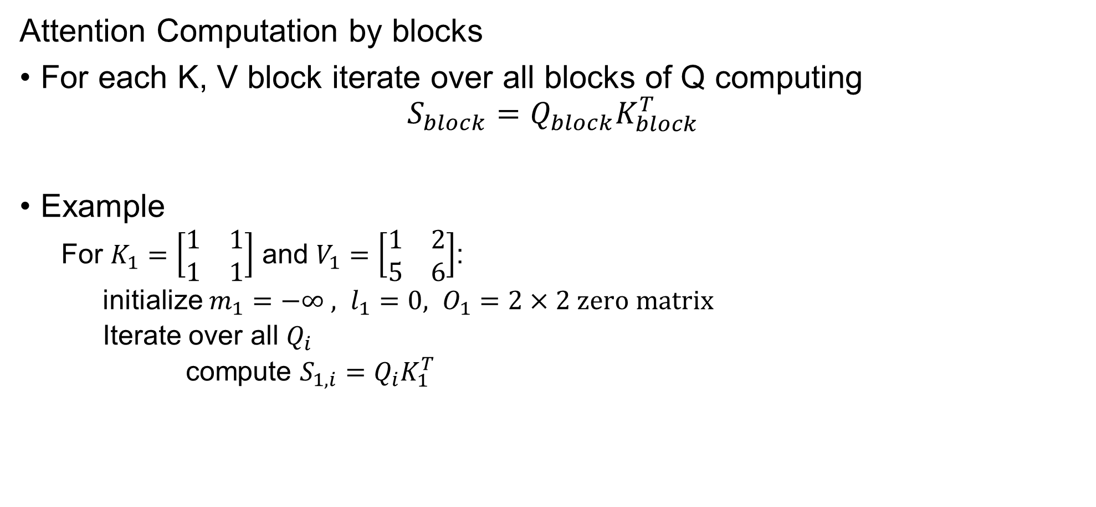
Flash Attention
Attention Computation by blocks
For each K, V block iterate over all blocks of Q computing
$$S_{block}=Q_{block}K_{block}^{T}$$
Example
For $K_{1}=\left[\begin{matrix}1 & 1 \\ 1 & 1\end{matrix}\right]$ and $V_{1}=\left[\begin{matrix}1 & 2 \\ 5 & 6\end{matrix}\right]$:
initialize $m_{1}=−∞ , l_{1}=0, O_{1}=2×2 \text{zero} \text{matrix}$
Iterate over all $Q_{i}$
compute $S_{1,i}=Q_{i}K_{1}^{T}$

Slide 31
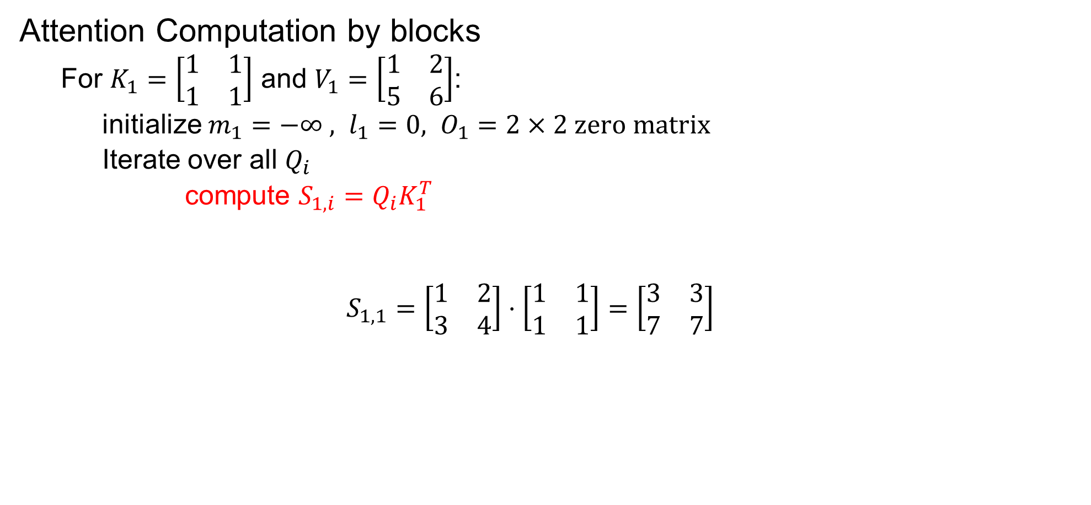
Flash Attention
Attention Computation by blocks
For $K_{1}=\left[\begin{matrix}1 & 1 \\ 1 & 1\end{matrix}\right]$ and $V_{1}=\left[\begin{matrix}1 & 2 \\ 5 & 6\end{matrix}\right]$:
initialize $m_{1}=−∞ , l_{1}=0, O_{1}=2×2 \text{zero} \text{matrix}$
Iterate over all $Q_{i}$
compute $S_{1,i}=Q_{i}K_{1}^{T}$
$$S_{1,1}=\left[\begin{matrix}1 & 2 \\ 3 & 4\end{matrix}\right]⋅\left[\begin{matrix}1 & 1 \\ 1 & 1\end{matrix}\right]=\left[\begin{matrix}3 & 3 \\ 7 & 7\end{matrix}\right]$$

Slide 32
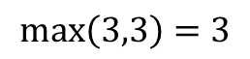
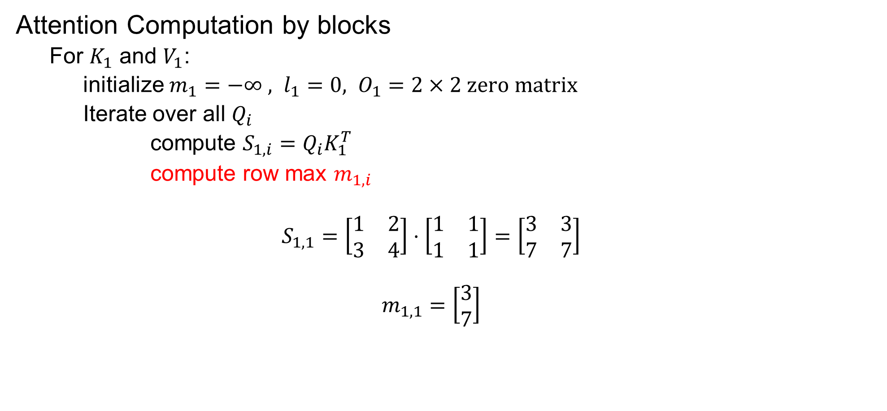
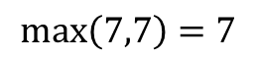
Flash Attention
Attention Computation by blocks
For $K_{1}$ and $V_{1}$:
initialize $m_{1}=−∞ , l_{1}=0, O_{1}=2×2 \text{zero} \text{matrix}$
Iterate over all $Q_{i}$
compute $S_{1,i}=Q_{i}K_{1}^{T}$
compute row max $m_{1,i}$
$$S_{1,1}=\left[\begin{matrix}1 & 2 \\ 3 & 4\end{matrix}\right]⋅\left[\begin{matrix}1 & 1 \\ 1 & 1\end{matrix}\right]=\left[\begin{matrix}3 & 3 \\ 7 & 7\end{matrix}\right]$$
$$m_{1,1}=\left[\begin{matrix}3 \\ 7\end{matrix}\right]$$
$$\max\left(3,3\right)=3$$
$$\max\left(7,7\right)=7$$

Slide 33
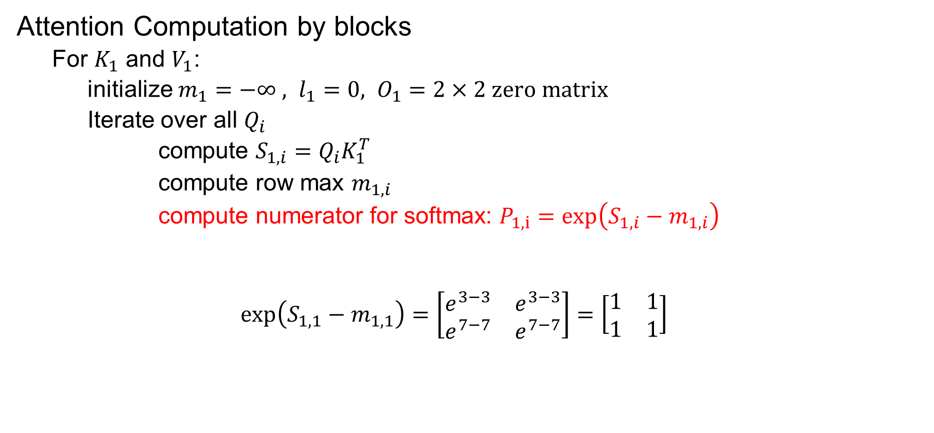
Flash Attention
Attention Computation by blocks
For $K_{1}$ and $V_{1}$:
initialize $m_{1}=−∞ , l_{1}=0, O_{1}=2×2 \text{zero} \text{matrix}$
Iterate over all $Q_{i}$
compute $S_{1,i}=Q_{i}K_{1}^{T}$
compute row max $m_{1,i}$
compute numerator for softmax: $P_{1,i}=\exp\left(S_{1,i}−m_{1,i}\right)$
$$\exp\left(S_{1,1}−m_{1,1}\right)=\left[\begin{matrix}e^{3−3} & e^{3−3} \\ e^{7−7} & e^{7−7}\end{matrix}\right]=\left[\begin{matrix}1 & 1 \\ 1 & 1\end{matrix}\right]$$

Slide 34
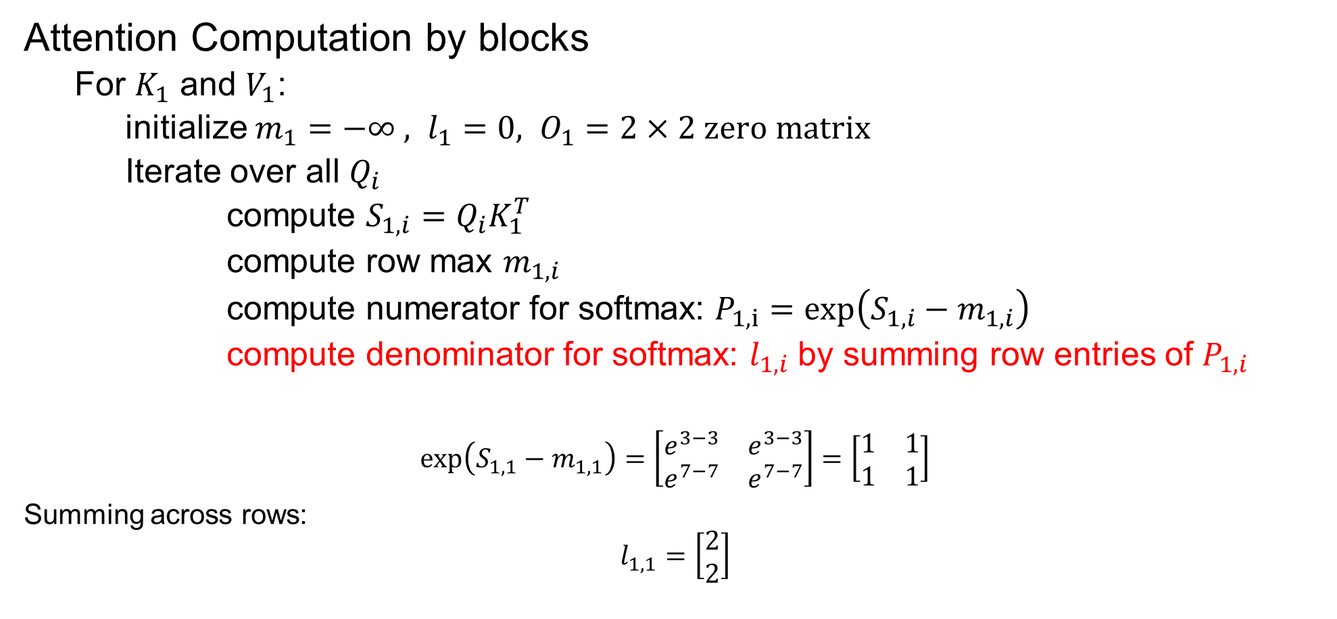
Flash Attention
Attention Computation by blocks
For $K_{1}$ and $V_{1}$:
initialize $m_{1}=−∞ , l_{1}=0, O_{1}=2×2 \text{zero} \text{matrix}$
Iterate over all $Q_{i}$
compute $S_{1,i}=Q_{i}K_{1}^{T}$
compute row max $m_{1,i}$
compute numerator for softmax: $P_{1,i}=\exp\left(S_{1,i}−m_{1,i}\right)$
compute denominator for softmax: $l_{1,i}$ by summing row entries of $P_{1,i}$
$$\exp\left(S_{1,1}−m_{1,1}\right)=\left[\begin{matrix}e^{3−3} & e^{3−3} \\ e^{7−7} & e^{7−7}\end{matrix}\right]=\left[\begin{matrix}1 & 1 \\ 1 & 1\end{matrix}\right]$$
Summing across rows:
$$l_{1,1}=\left[\begin{matrix}2 \\ 2\end{matrix}\right]$$

Slide 35
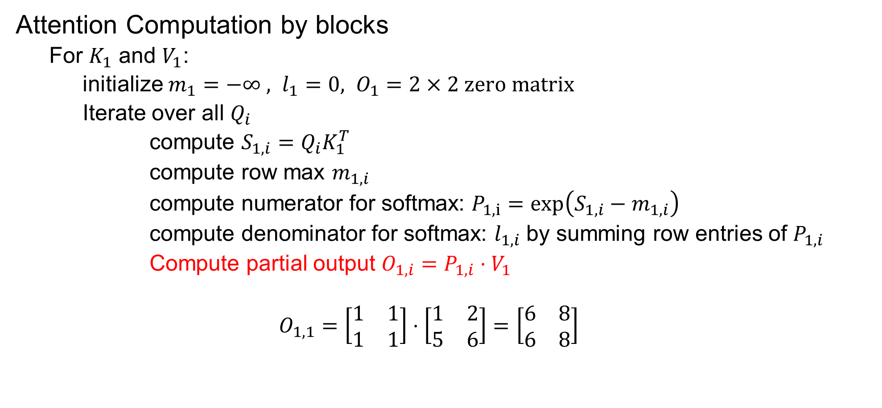
Flash Attention
Attention Computation by blocks
For $K_{1}$ and $V_{1}$:
initialize $m_{1}=−∞ , l_{1}=0, O_{1}=2×2 \text{zero} \text{matrix}$
Iterate over all $Q_{i}$
compute $S_{1,i}=Q_{i}K_{1}^{T}$
compute row max $m_{1,i}$
compute numerator for softmax: $P_{1,i}=\exp\left(S_{1,i}−m_{1,i}\right)$
compute denominator for softmax: $l_{1,i}$ by summing row entries of $P_{1,i}$
Compute partial output $O_{1,i}=P_{1,i}⋅V_{1}$
$$O_{1,1}=\left[\begin{matrix}1 & 1 \\ 1 & 1\end{matrix}\right]⋅\left[\begin{matrix}1 & 2 \\ 5 & 6\end{matrix}\right]=\left[\begin{matrix}6 & 8 \\ 6 & 8\end{matrix}\right]$$

Slide 36
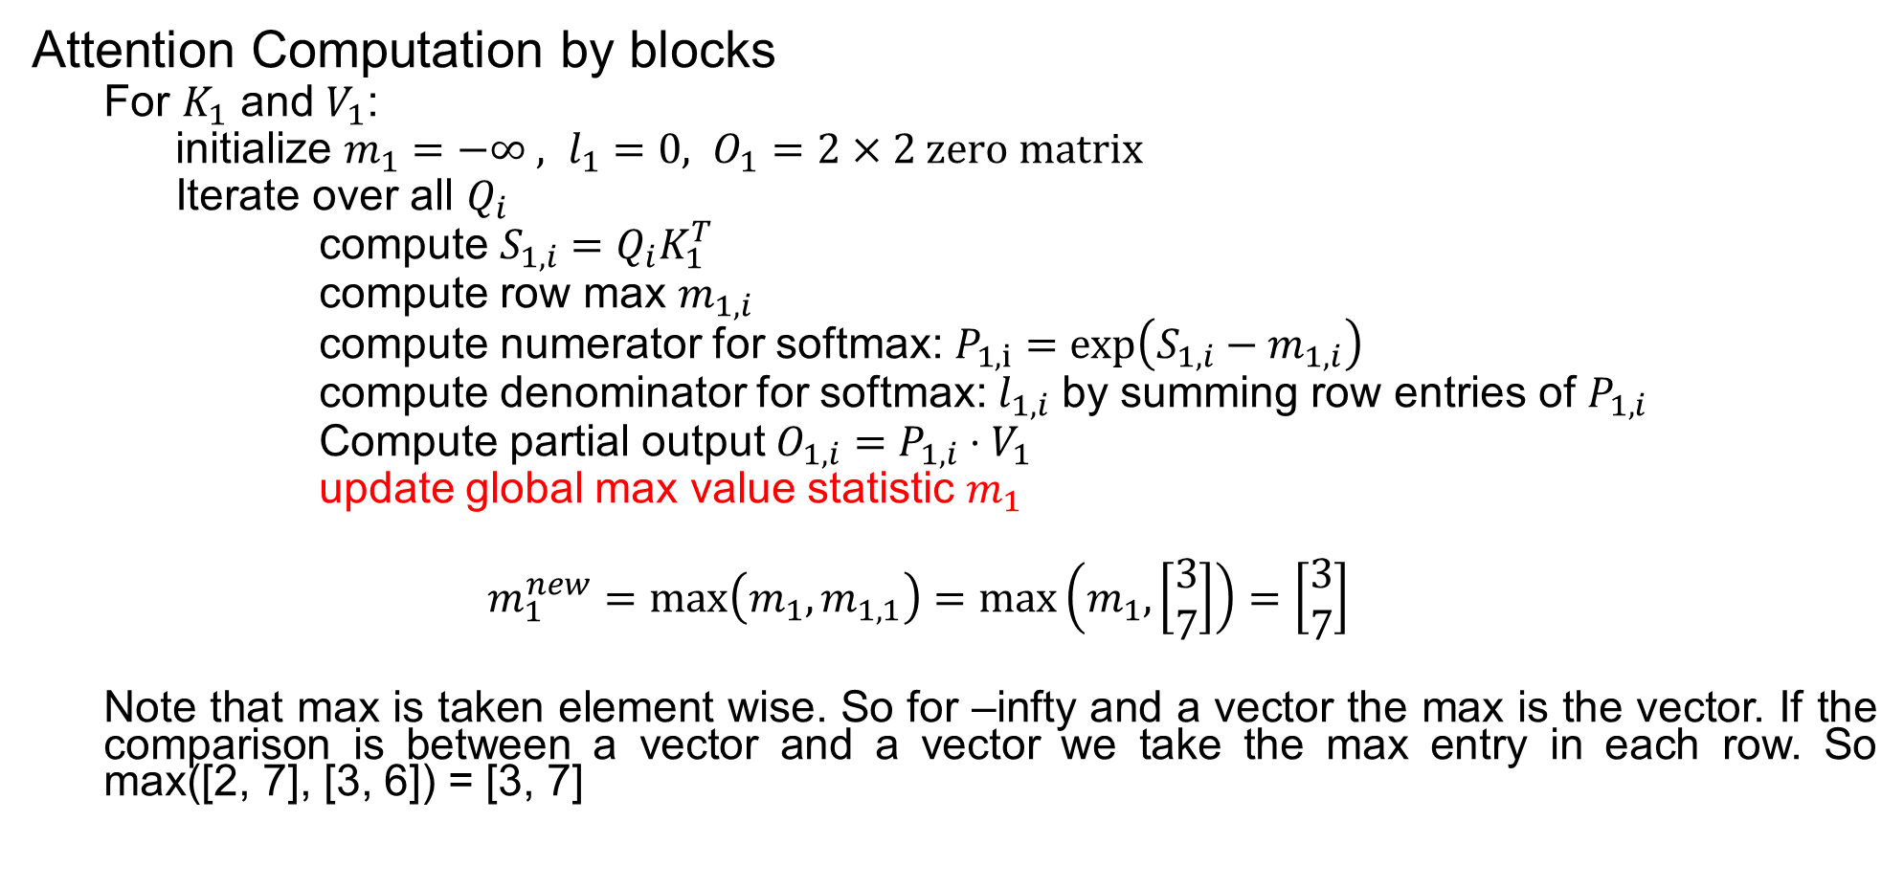
Flash Attention
Attention Computation by blocks
For $K_{1}$ and $V_{1}$:
initialize $m_{1}=−∞ , l_{1}=0, O_{1}=2×2 \text{zero} \text{matrix}$
Iterate over all $Q_{i}$
compute $S_{1,i}=Q_{i}K_{1}^{T}$
compute row max $m_{1,i}$
compute numerator for softmax: $P_{1,i}=\exp\left(S_{1,i}−m_{1,i}\right)$
compute denominator for softmax: $l_{1,i}$ by summing row entries of $P_{1,i}$
Compute partial output $O_{1,i}=P_{1,i}⋅V_{1}$
update global max value statistic $m_{1}$
$$m_{1}^{new}=\max\left(m_{1},m_{1,1}\right)=\max\left(m_{1},\left[\begin{matrix}3 \\ 7\end{matrix}\right]\right)=\left[\begin{matrix}3 \\ 7\end{matrix}\right]$$
Note that max is taken element wise. So for –infty and a vector the max is the vector. If the comparison is between a vector and a vector we take the max entry in each row. So max([2, 7], [3, 6]) = [3, 7]

Slide 37
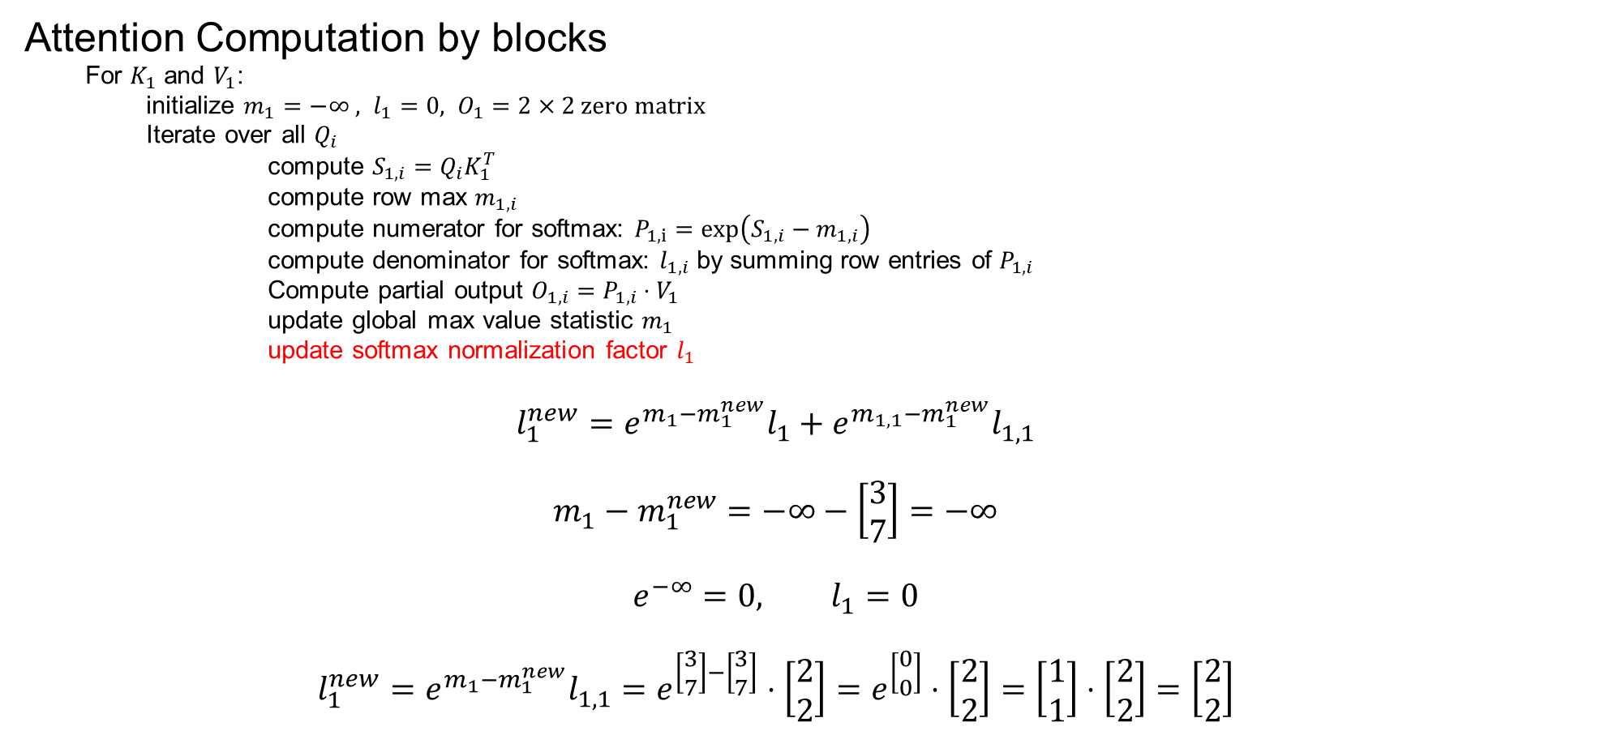
Flash Attention
Attention Computation by blocks
For $K_{1}$ and $V_{1}$:
initialize $m_{1}=−∞ , l_{1}=0, O_{1}=2×2 \text{zero} \text{matrix}$
Iterate over all $Q_{i}$
compute $S_{1,i}=Q_{i}K_{1}^{T}$
compute row max $m_{1,i}$
compute numerator for softmax: $P_{1,i}=\exp\left(S_{1,i}−m_{1,i}\right)$
compute denominator for softmax: $l_{1,i}$ by summing row entries of $P_{1,i}$
Compute partial output $O_{1,i}=P_{1,i}⋅V_{1}$
update global max value statistic $m_{1}$
update softmax normalization factor $l_{1}$
$$l_{1}^{new}=e^{m_{1}−m_{1}^{new}}l_{1}+e^{m_{1,1}−m_{1}^{new}}l_{1,1}$$
$$m_{1}−m_{1}^{new}=−∞−\left[\begin{matrix}3 \\ 7\end{matrix}\right]=−∞$$
$$e^{−∞}=0, l_{1}=0$$
$$l_{1}^{new}=e^{m_{1}−m_{1}^{new}}l_{1,1}=e^{\left[\begin{matrix}3 \\ 7\end{matrix}\right]−\left[\begin{matrix}3 \\ 7\end{matrix}\right]}⋅\left[\begin{matrix}2 \\ 2\end{matrix}\right]=e^{\left[\begin{matrix}0 \\ 0\end{matrix}\right]}⋅\left[\begin{matrix}2 \\ 2\end{matrix}\right]=\left[\begin{matrix}1 \\ 1\end{matrix}\right]⋅\left[\begin{matrix}2 \\ 2\end{matrix}\right]=\left[\begin{matrix}2 \\ 2\end{matrix}\right]$$

Slide 38
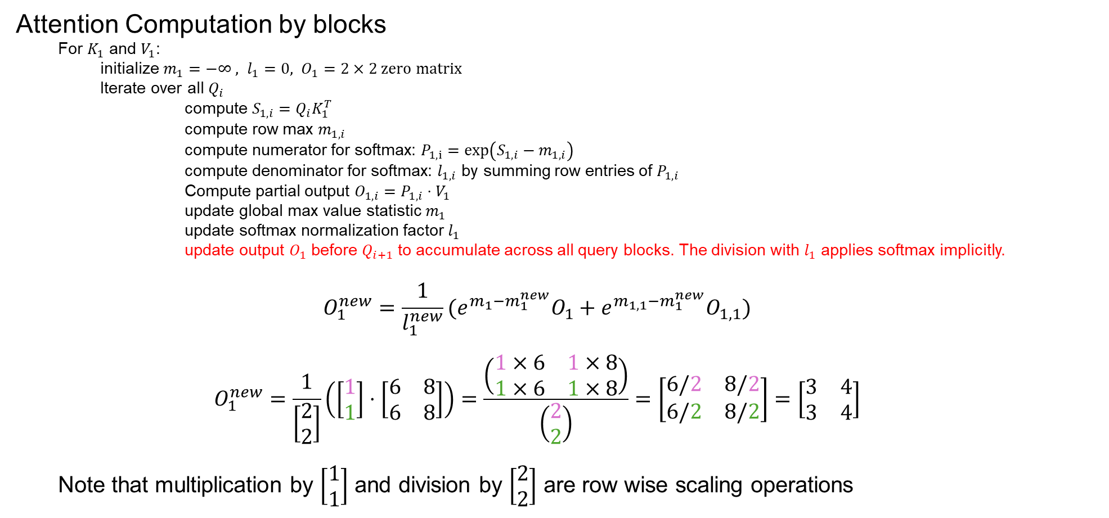
Flash Attention
Attention Computation by blocks
For $K_{1}$ and $V_{1}$:
initialize $m_{1}=−∞ , l_{1}=0, O_{1}=2×2 \text{zero} \text{matrix}$
Iterate over all $Q_{i}$
compute $S_{1,i}=Q_{i}K_{1}^{T}$
compute row max $m_{1,i}$
compute numerator for softmax: $P_{1,i}=\exp\left(S_{1,i}−m_{1,i}\right)$
compute denominator for softmax: $l_{1,i}$ by summing row entries of $P_{1,i}$
Compute partial output $O_{1,i}=P_{1,i}⋅V_{1}$
update global max value statistic $m_{1}$
update softmax normalization factor $l_{1}$
update output $O_{1}$ before $Q_{i+1}$ to accumulate across all query blocks. The division with $l_{1}$ applies softmax implicitly.
$$O_{1}^{new}=\frac{1}{l_{1}^{new}}{(e}^{m_{1}−m_{1}^{new}}O_{1}+e^{m_{1,1}−m_{1}^{new}}O_{1,1})$$
$$O_{1}^{new}=\frac{1}{\left[\begin{matrix}2 \\ 2\end{matrix}\right]}\left(\left[\begin{matrix}1 \\ 1\end{matrix}\right]⋅\left[\begin{matrix}6 & 8 \\ 6 & 8\end{matrix}\right]\right)=\frac{\left(\begin{matrix}1×6 & 1×8 \\ 1×6 & 1×8\end{matrix}\right)}{\left(\begin{matrix}2 \\ 2\end{matrix}\right)}=\left[\begin{matrix}6/2 & 8/2 \\ 6/2 & 8/2\end{matrix}\right]=\left[\begin{matrix}3 & 4 \\ 3 & 4\end{matrix}\right]$$
Note that multiplication by $\left[\begin{matrix}1 \\ 1\end{matrix}\right]$ and division by $\left[\begin{matrix}2 \\ 2\end{matrix}\right]$ are row wise scaling operations
Simplified

Slide 39
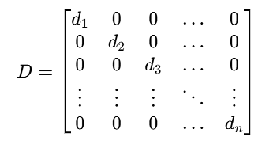
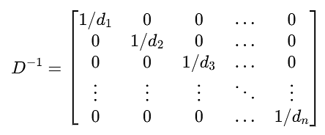
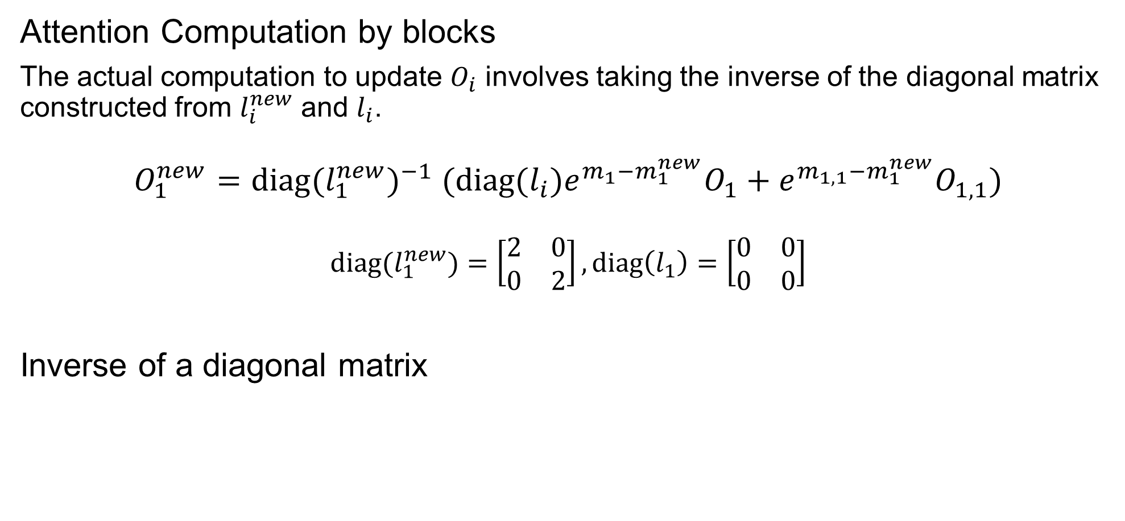
Flash Attention
Attention Computation by blocks
The actual computation to update $O_{i}$ involves taking the inverse of the diagonal matrix constructed from $l_{i}^{new}$ and $l_{i}$.
$$O_{1}^{new}={{\text{diag}(l}_{1}^{new})}^{−1} {(\text{diag}(l_{i})e}^{m_{1}−m_{1}^{new}}O_{1}+e^{m_{1,1}−m_{1}^{new}}O_{1,1})$$
$${\text{diag}(l}_{1}^{new})=\left[\begin{matrix}2 & 0 \\ 0 & 2\end{matrix}\right],\text{diag}\left(l_{1}\right)=\left[\begin{matrix}0 & 0 \\ 0 & 0\end{matrix}\right]$$
Inverse of a diagonal matrix

Slide 40
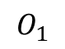
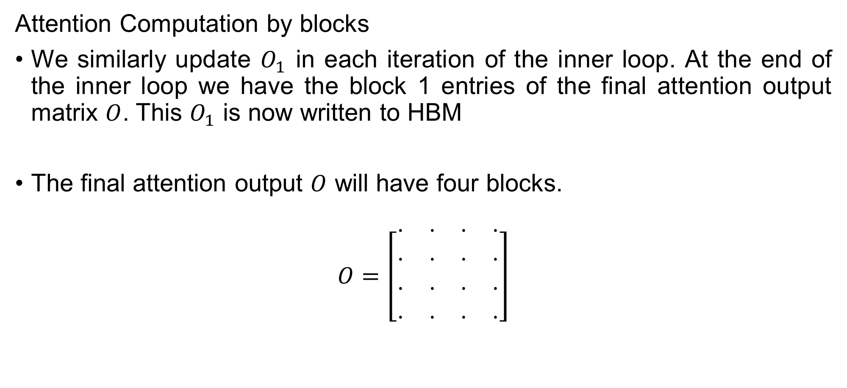
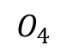
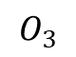
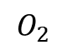
Flash Attention
Attention Computation by blocks
We similarly update $O_{1}$ in each iteration of the inner loop. At the end of the inner loop we have the block 1 entries of the final attention output matrix $O$. This $O_{1}$ is now written to HBM
The final attention output $O$ will have four blocks.
$$O=\left[\begin{matrix}⋅ & ⋅ & ⋅ & ⋅ \\ ⋅ & ⋅ & ⋅ & ⋅ \\ ⋅ & ⋅ & ⋅ & ⋅ \\ ⋅ & ⋅ & ⋅ & ⋅\end{matrix}\right]$$
$$O_{1}$$
$$O_{2}$$
$$O_{3}$$
$$O_{4}$$

Slide 41
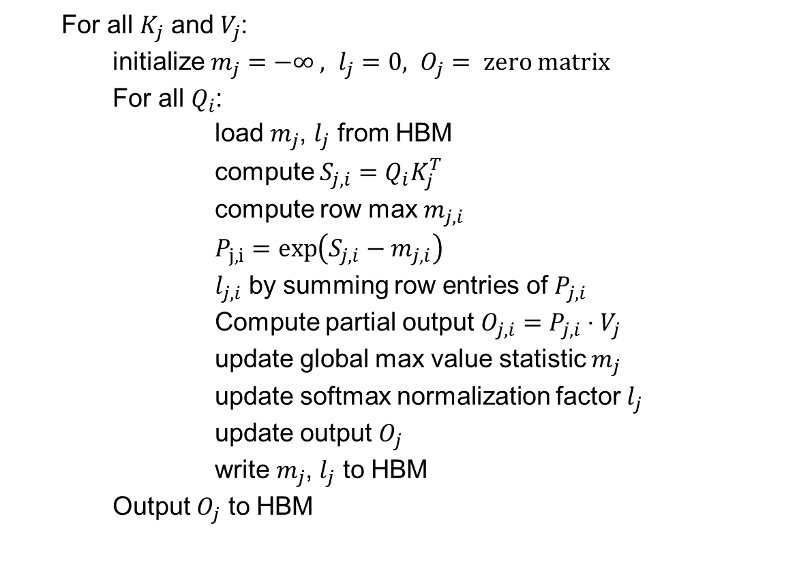
Flash Attention
Tiling: Attention Computation by blocks
For all $K_{j}$ and $V_{j}$:
initialize $m_{j}=−∞ , l_{j}=0, O_{j}= \text{zero} \text{matrix}$
For all $Q_{i}$:
load $m_{j}$, $l_{j}$ from HBM
compute $S_{j,i}=Q_{i}K_{j}^{T}$
compute row max $m_{j,i}$
$P_{j,i}=\exp\left(S_{j,i}−m_{j,i}\right)$
$l_{j,i}$ by summing row entries of $P_{j,i}$
Compute partial output $O_{j,i}=P_{j,i}⋅V_{j}$
update global max value statistic $m_{j}$
update softmax normalization factor $l_{j}$
update output $O_{j}$
write $m_{j}$, $l_{j}$ to HBM
Output $O_{j}$ to HBM

Slide 42
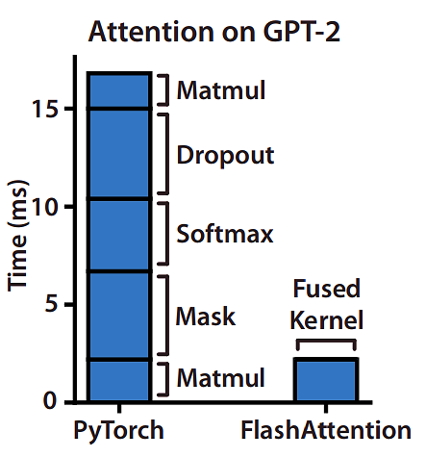
Flash Attention
Speedup over the PyTorch implementation of attention on GPT-2.
FlashAttention does not read and write the large 𝑁 × 𝑁 attention matrix to HBM, resulting in an 7.6X speedup on the attention computation.

Slide 43
Mixture of Experts
We have explored how advanced attention mechanisms enhance efficiency. However, the majority of parameters in a Large Language Model (LLM) reside in the Feed-Forward Network (FFN) layers.

Slide 44
Mixture of Experts
We have explored how advanced attention mechanisms enhance efficiency. However, the majority of parameters in a Large Language Model (LLM) reside in the Feed-Forward Network (FFN) layers.
Increasing the number of parameters in a model improves performance by capturing more complex patterns.
More parameters, however, lead to higher computational costs, longer training times, and slower inference.

Slide 45
Mixture of Experts
How can we increase parameters without higher computational cost and training time?
The Mixture-of-Expert (MoE) structure (Jacobs et al., 1991; Jordan and Jacobs, 1994) is a classic design that substantially scales up the model capacity and only introduces small computation overhead.
Mixture of Experts (MoE) increases model capacity while maintaining efficiency by using sparse activation of subnetworks.
MoE consists of multiple expert networks, but only a subset is activated per input, reducing computation.

Slide 46
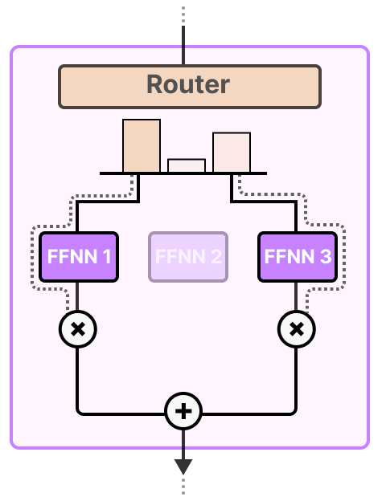
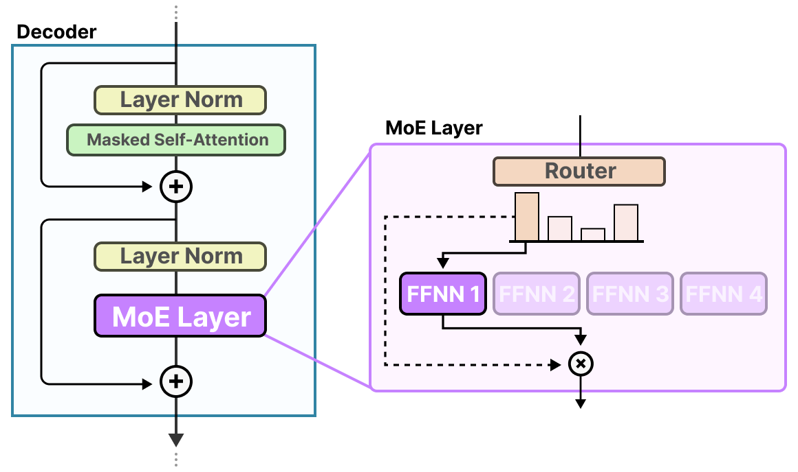
Mixture of Experts
MoE layer contains many experts (non linear neural networks) that share the same network architecture and are trained by the same algorithm, with a gating (or routing) network that routes individual inputs to a few experts among all the candidates.
MoE layer

Slide 47

Mixture of Experts
Sparse Layers
The FFNN in a traditional Transformer is called a dense model since all parameters (its weights and biases) are activated. Nothing is left behind and everything is used to calculate the output.
The input activates all parameters to some degree:

Slide 48

Mixture of Experts
Sparse Layers
Sparse models only activate a portion of their total parameters and are closely related to Mixture of Experts.
In MoE, we can chop up our dense model into pieces (so-called experts), retrain it, and only activate a subset of experts at a given time:

Slide 49

Mixture of Experts
The underlying idea is that each expert learns different information during training. Then, when running inference, only specific experts are used as they are most relevant for a given task.
When asked a question, we can select the expert best suited for a given task:

Slide 50

Mixture of Experts
All Experts in the MoE layer are FFNNs themselves. All experts have the same structure, initialized from the same weight distribution and are trained with the same optimization configuration.

Slide 51

Mixture of Experts
The Routing Mechanism
The router (or gate network) is also an FFNN and is used to choose the expert based on a particular input. It outputs probabilities which it uses to select the best matching expert:

Slide 52




Mixture of Experts
The Routing Mechanism
The gating network is arguably the most important component of any MoE as it not only decides which experts to choose during inference but also training.

Slide 53







Mixture of Experts
The Routing Mechanism
The gating network is arguably the most important component of any MoE as it not only decides which experts to choose during inference but also training.
$$y=G{\left(x\right)}_{2}y_{2}+G{\left(x\right)}_{n−1}y_{n−1}$$
$$+$$
$$×$$
$$×$$
Expert 1
Expert 2
$$⋯$$
Expert n-1
Expert n
$$G{\left(x\right)}_{2}$$
Gating Network
$$G{\left(x\right)}_{n−1}$$
x

Slide 54

Mixture of Experts
The Routing Mechanism
Since most LLMs have several decoder blocks, a given text will pass through multiple experts before the text is generated:

Slide 55

Mixture of Experts
The Routing Mechanism
The chosen experts likely differ between tokens which results in different “paths” being taken:

Slide 56

Mixture of Experts
Load Balancing
The simple routing function often results in the router choosing the same expert since certain experts might learn faster than others Not only will there be an uneven distribution of experts chosen, but some experts will hardly be trained at all. This results in issues during both training and inference.

Slide 57

Mixture of Experts
Load Balancing
To balance the importance of experts, we will need to look at the router as it is the main component to decide which experts to choose at a given time. One method of load balancing the router is through a straightforward extension called KeepTopK2. By introducing trainable (gaussian) noise, we can prevent the same experts from always being picked:

Slide 58



Mixture of Experts
Load Balancing
Then, all but the top k experts that you want activating (for example 2) will have their weights set to $−∞$. By setting these weights to $−∞$, the output of the SoftMax on these weights will result in a probability of 0:

Slide 59


Mixture of Experts
Load Balancing
The KeepTopK strategy routes each token to a few selected experts. This method is called Token Choice3 and allows for a given token to be sent to one expert (top-1 routing) or to more than one expert (top-k routing):

Slide 60
Mixture of Experts
Auxiliary Loss
To get a more even distribution of experts during training, the auxiliary loss (also called load balancing loss) was added to the network’s regular loss.
It adds a constraint that forces experts to have equal importance.

Slide 61

Mixture of Experts
Auxiliary Loss
The first component of this auxiliary loss is to sum the router values for each expert over the entire batch:
This gives us the importance scores per expert which represents how likely a given expert will be chosen regardless of the input.

Slide 62



Mixture of Experts
Auxiliary Loss
We can use this to calculate the coefficient variation (CV), which tells us how different the importance scores are between experts.
If there are a lot of differences in importance scores, the CV will be high. In contrast, if all experts have similar importance scores, the CV will be low (which is what we aim for):

Slide 63

Mixture of Experts
Auxiliary Loss
Using this CV score, we can update the auxiliary loss during training such that it aims to lower the CV score as much as possible (thereby giving equal importance to each expert):
Finally, the auxiliary loss is added as a separate loss to optimize during training.

Slide 64

Mixture of Experts
Expert Capacity
Imbalance is not just found in the experts that were chosen but also in the distributions of tokens that are sent to the expert. For instance, if input tokens are disproportionally sent to one expert over another then that might also result in undertraining:

Slide 65

Mixture of Experts
Expert Capacity
A solution to this problem is to limit the amount of tokens a given expert can handle, namely Expert Capacity. By the time an expert has reached capacity, the resulting tokens will be sent to the next expert:

Slide 66

Mixture of Experts
Expert Capacity
If both experts have reached their capacity, the token will not be processed by any expert but instead sent to the next layer. This is referred to as token overflow.

Slide 67
References
Dao, Tri, et al. FlashAttention: Fast and Memory-Efficient Exact Attention with IO-Awareness. Advances in Neural Information Processing Systems (NeurIPS), 2022
Alammar, Jay, and Maarten Grootendorst. Hands-On Large Language Models: Language Understanding and Generation. O’Reilly Media, 2024.
Grootendorst, M. (2024, October 7). A Visual Guide to Mixture of Experts (MoE): Demystifying the role of MoE in Large Language Models. Exploring Language Models.

